Slide 1
Cloud Service Models
Narendra Maharjan

Slide 2
Communication as a Service
What is Cloud communication?
Cloud communications are Internet-based voice and data communications where telecommunications applications, switching and storage are hosted by a third-party outside of the organization using them, and they are accessed over the public Internet.
Cloud communications providers deliver voice and data communications applications and services, hosting them on servers that the providers own and maintain, giving their customers access to the “cloud.”
customers have a more cost-effective, reliable and secure communications environment, without the headaches associated with more conventional PBX system deployment.
Notes:
A PBX (private branch exchange) is a telephone system within an enterprise that switches calls between enterprise users on local lines while allowing all users to share a certain number of external phone lines.

Slide 3
Communication as a Service
Cloud communications contd.
Services include distributed call centres and economical teleworking.
For a small or medium-sized business, the capital investment to set up VoIP infrastructure in-house could be too high compared to the potential return, but cloud telephony could offer the same services on a lower-cost subscription basis.
Examples: BluIP, Nextiva etc.

Slide 4
Communication as a Service
Communications as a Service (CaaS) provides Software as a Service (SaaS) for communications.
There is no standard specification as to what is included in CaaS. Implementations vary.
CaaS could include unified communications, broadcasting, individual calls (voice and video), conferencing (voice and video), voice over IP (VoIP), messaging, and so on

Slide 5
Communication as a Service
The CaaS vendor is responsible for all hardware and Software management and offers guaranteed Quality of Service (QoS).
CaaS allows businesses to selectively deploy communications devices and modes on a pay-as-you-go, as-needed basis.
This approach eliminates the large capital investment and ongoing overhead for a system whose capacity may often exceed or fall short of current demand.

Slide 6
Advantages of Communication as a Service (CaaS)
Fully Integrated Enterprise Class Unified Communication:
No Upfront Capital Expenses:
Flexibility in Features:
No Risk of Obsolescence:
Guaranteed Business Continuity:

Slide 7
Advantages of Communication as a Service (CaaS)
Fully Integrated Enterprise Class Unified Communication:
By managing the LAN/WAN, the vendor can guarantee consistent Quality of Service (QoS) from the desktop across the VoIP backbone and back again.
Advanced Unified Communications features such as Outlook integration, soft phones, real-time presence, chat, multimedia conferencing, video calling, unified messaging and mobility are also part of a standard CaaS deployment.
Development and introduction of new features and applications are faster, easier and more economical because the service provider is doing the work for multiple end users across a scalable platform.

Slide 8
Advantages of Communication as a Service (CaaS)
No Upfront Capital Expenses:
Since cloud services are supposed to lower capital expenditure and focus more on operating expenditure, by implementing CaaS, consumers can build up their communication infrastructure without any upfront cost. They just need to pay it as a service.
Flexibility in Features:
Since cloud is a multi-tenant architecture, cloud vendors have to manage multiple customers and look after the features that they want. What this allows cloud vendor is to add more advanced features and flexibility in their service model.

Slide 9
Advantages of Communication as a Service (CaaS)
No Risk of Obsolescence:
Technology changes rapidly and are obsolete within few years of introduction. With CaaS, companies are always privileged with new technologies as cloud vendors keep on updating their equipment’s and technologies to sustain in market.
Guaranteed Business Continuity:
With CaaS, organization can be hugely benefitted with guaranteed business continuity as cloud service providers proactively plans for Business Continuity Planning for their customers. Service uptime is guaranteed even if any catastrophic disaster strikes.

Slide 10
Unified Communications
Unified communications (UC) is a business term describing the integration of enterprise communication services.
communications integrated to optimize business processes and increase user productivity.
Unified communications is an evolving set of technologies that automates and unifies human and device communications in a common context and experience.

Slide 11
Unified Communications
In its broadest sense, UC can encompass all forms of communications that are exchanged via a network to include other forms of communications such as Internet Protocol Television (IPTV)and digital signage Communications
Notes:
signage is the design or use of signs and symbols to communicate a message to a specific group( LED panel display)

Slide 12
IaaS: Modern on demand Computing
On-demand computing is an increasingly popular enterprise model in which computing resources are made available to the user as needed.
The on-demand model evolved to overcome the challenge of being able to meet fluctuating resource demands efficiently.
Demand for computing resources can vary drastically from one time to another, maintaining sufficient resources to meet peak requirements can be costly.

Slide 13
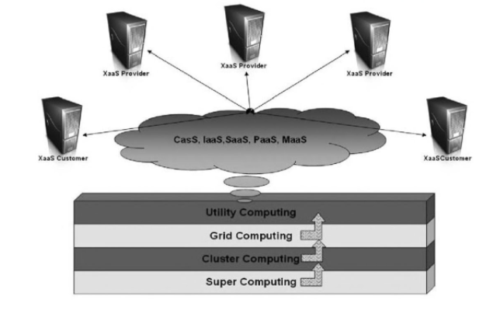
IaaS: Modern on demand Computing
Concepts such as clustered computing, grid computing, utility computing etc. may all seem very similar to the concept of on-demand computing but they can be better understood if one think of them as building blocks.
That evolved over time and with techno –evolution to achieve the modern cloud computing model we think of and use today. Eg. amazon elastic cloud.

Slide 14
Amazon’s Elastic Cloud
This is a web service that provides resizable computing capacity in the cloud. It is designed to make web-scale computing easier for developers.
Amazon EC2 presents a true virtual computing environment, allowing clients to use a web-based interface to obtain and manage services needed to launch one or more instances of a variety of operating systems.
In order to use Amazon EC2, clients first need to create an Amazon Machine Image (AMI). This image contains the applications, libraries, data, and associated configuration settings used in the virtual computing environment.
Notes:
Amazon elastic compute cloud, Mosso (Rackspace)

Slide 15
Amazon’s Elastic Cloud
Assignment:
Write report on Amazon EC2.
Introduction, uses procedure, advantages and disadvantages and so on.
At least 2 printed A4 pages with Times new Roman font size 12.

Slide 16
Amazon EC2 Service Characteristics
Dynamic Scalability
Full Control of Instances
Configuration Flexibility
Integration with Other Amazon Web Services
Reliable and Resilient Performance
Elastic IP Addressing

Slide 17
Amazon EC2 Service Characteristics
Dynamic Scalability
Amazon EC2 enables users to increase or decrease capacity in a few minutes. Users can invoke a single instance, hundreds of instances, or even thousands of instances simultaneously.
This type of dynamic scalability is very attractive to enterprise customers because it allows them to meet their customers’ demands without having to overbuild their infrastructure.

Slide 18
Amazon EC2 Service Characteristics
Full Control of Instances
Users have root access to each instance and can interact with them as one would with any machine. Instances can be rebooted remotely using web service APIs.
Once users have set up their account and uploaded their AMI to the Amazon S3 service, they just need to boot that instance.

Slide 19
Amazon EC2 Service Characteristics
Configuration Flexibility
Configuration settings can vary widely among users.
They have the choice of multiple instance types, operating systems, and software packages. Amazon EC2 allows them to select a configuration of memory, CPU, and instance storage that is optimal for their choice of operating system and application.

Slide 20
Amazon EC2 Service Characteristics
Integration with Other Amazon Web Services
Amazon EC2 works in conjunction with a variety of other Amazon web services. For Eg
Amazon S3 provides a web services interface that allows users to store and retrieve any amount of data from the Internet at any time, anywhere.
Amazon SimpleDB is another web-based service, designed for running queries on structured data stored with the Amazon Simple Storage Service (Amazon S3) in real time.
Amazon Simple Queue Service (Amazon SQS) is a reliable, scalable, hosted queue for storing messages as they pass between computers.
Amazon CloudFront is a web service for content delivery.

Slide 21
Amazon EC2 Service Characteristics
Reliable and Resilient Performance
Amazon Elastic Block Store (EBS) is yet another Amazon EC2 feature that provides users powerful features to build failure-resilient applications. Amazon EBS volumes are automatically replicated on the back end. The service provides users with the ability to create point-in-time snapshots of their data volumes, which are stored using the Amazon S3 service.
Amazon EC2 provides users with the ability to place one or more instances in multiple locations. Availability Zones are distinct locations that are engineered to be insulated from failures in other Availability Zones and provide inexpensive, low-latency network connectivity to other Availability Zones in the same Region.
Notes:
Resilient(quickly recover)

Slide 22
Amazon EC2 Service Characteristics
Elastic IP Addressing
Elastic IP (EIP) addresses are static IP addresses designed for dynamic cloud computing.
An Elastic IP address is associated with your account and not with a particular instance, and you control that address until you choose explicitly to release it.
A significant feature of Elastic IP addressing is that each IP address can be reassigned to a different instance when needed.

Slide 23
Monitoring as a service (MaaS)
Monitoring as a service (MaaS) is one of many cloud delivery models under anything as a service (XaaS).
It is a framework that facilitates the deployment of monitoring functionalities for various other services and applications within the cloud.
The most common application for MaaS is online state monitoring, which continuously tracks certain states of applications, networks, systems, instances or any element that may be deployable within the cloud.

Slide 24
Monitoring as a service (MaaS)
MaaS offerings consist of multiple tools and applications meant to monitor a certain aspect of an application, server, system or any other IT component.
The tools being offered by MaaS providers may vary in some ways, but there are very basic monitoring schemes that have become ad hoc standards simply because of their benefits.
State monitoring is one of them, and has become the most widely used feature. It is the overall monitoring of a component in relation to a set metric or standard. In state monitoring, a certain aspect of a component is constantly evaluated, and results are usually displayed in real time or periodically updated as a report.
Examples: LogicMonitor, Amazon CloudWatch, Aternity etc.

Slide 25
Protection Against Internal and External Threats
Security Operations Centers(SOC) based security monitoring services can improve the effectiveness of a customer security infrastructure by actively analyzing logs and alerts from infrastructure devices around the clock and in real time.
Typical services provided by many MaaS vendors are described below.
An early detection service detects and reports new security vulnerabilities shortly after they appear. Generally, the threats are correlated with thirdparty sources, and an alert or report is issued to customers.

Slide 26
Protection Against Internal and External Threats
services provided by Mass contd...
Platform, control, and services monitoring is often implemented as a dashboard interface and makes it possible to know the operational status of the platform being monitored at any time.
Intelligent log centralization and analysis is a monitoring solution based mainly on the correlation and matching of log entries.
Vulnerabilities detection and management enables automated verification which periodically performs a series of automated tests for the purpose of identifying system weaknesses that may be exposed over the Internet, including the possibility of unauthorized access to administrative services, the existence of services that have not been updated, the detection of vulnerabilities such as phishing, etc.

Slide 27
Protection Against Internal and External Threats
services provided by Mass contd...
Continuous System Patching/Upgrade and Fortification
Quick intervention when a threat is detected is crucial to mitigating the effects of a threat. When a detected threat is analyzed, it often requires forensic analysis to determine what it is, how much effort it will take to fix the problem, and what effects are likely to be seen.

Slide 28
The Traditional On-Premises Model
The traditional approach of building and running on-premises applications has always been complex, expensive, and risky.
Each application was designed to meet specific business requirements. Each solution required a specific set of hardware, an operating system, a database, often a middleware package, email and web servers, etc.
a team of developers had to navigate complex programming development platforms to build their applications. Additionally, a team of network, database, and system management experts was needed to keep everything up and running.

Slide 29
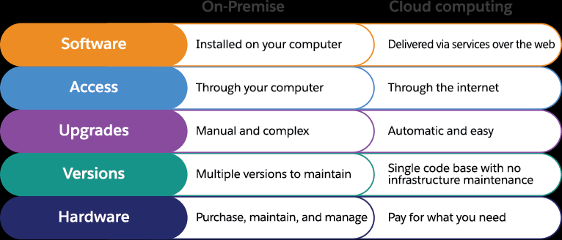

Slide 30
The new Cloud Model (PaaS)
PaaS offers a faster, more cost-effective model for application development and delivery.
PaaS is based on a metering or subscription model, so users pay only for what they use.
PaaS offerings include workflow facilities for application design, application development, testing, deployment, and hosting, as well as application services such as virtual offices, team collaboration, database integration, security, scalability, storage, persistence, state management, dashboard instrumentation, etc.

Slide 31
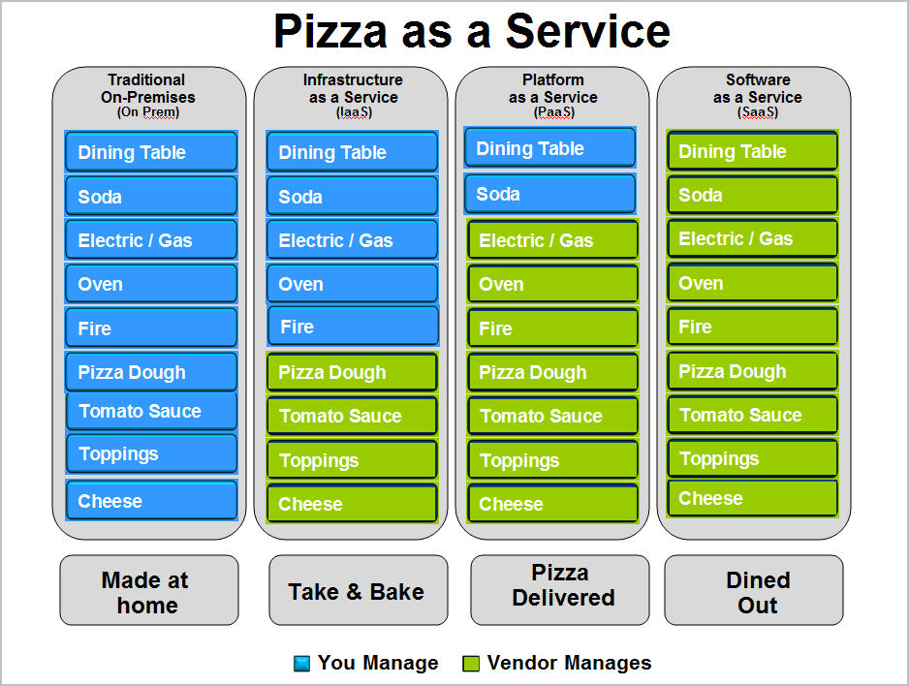

Slide 32
Key Characteristics of PaaS
Runtime Framework:
The PaaS runtime framework executes end-user code according to policies set by the application owner and cloud provider.
PaaS runtime frameworks come in many flavors, some based on traditional application runtimes, others based on 4GL and visual programming concepts.
Abstraction:
Platform-oriented cloud platforms are distinguished by the higher level of abstraction they provide.
with PaaS, the focus is on the applications that the cloud must support.
a PaaS cloud provides the user a way to deploy their applications into a seemingly limitless pool of computing resources, eliminating the complexity of deployment and infrastructure configuration.

Slide 33
Key Characteristics of PaaS
Automation:
PaaS environments automate the process of deploying applications to infrastructure, configuring application components, provisioning and configuring supporting technology like load balancers and databases, and managing system change based on policies set by the user.
Cloud Services:
PaaS offerings provide developers and architects with services and APIs that help simplify the job of delivering elastically scalable, highly available cloud applications.
These cloud services provide a wide variety of capabilities, and in many instances are key differentiators among competing PaaS offerings.

Slide 34
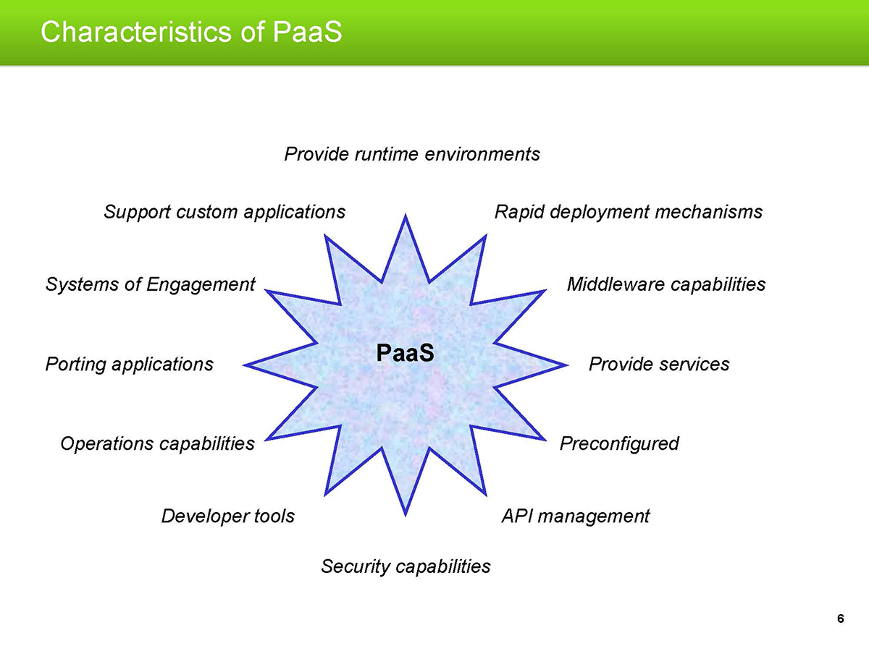

Slide 35
SaaS Implementation Issues
Security
Integration Inefficiencies
Network Limits
Dealing with Data
Starting From Scratch

Slide 36
SaaS Implementation Issues
Security
Security remains a top concern for any organization considering a move to the cloud. Some companies delay adoption until they’re confident off-premises security solutions can measure up to local defenses while others charge ahead and hope providers are ready for the challenge.
Integration Inefficiencies
How will new cloud systems work with legacy solutions? This question is top of mind for many IT admins and C-suite executives on the road to cloud implementation but ignores a critical factor: employee integration. If users aren’t ready to onboard the new cloud system, they can sink almost any investment through lack of adoption, or by using cloud services which aren’t approved by local IT.

Slide 37
SaaS Implementation Issues
Network Limits
Networks also pose a problem for cloud integration. Why? Because companies are often hyper-focused on cloud resources as the end goal but may forget that in order to effectively access data analytics, disaster recovery or collaboration tools, their network connection must be ready to handle the bandwidth.
Dealing with Data
As noted by Cloud Tech, big data continues to be a big draw for companies moving to the cloud. With even small and midsize firms generating massive amounts of data moment to moment, there’s vast potential for insight and action. However, there’s a catch: If the velocity and volume of data proves too much to handle, companies could end up losing more than they gain.

Slide 38
SaaS Implementation Issues
Starting From Scratch
The final implementation challenge? Developing a set of best practices to govern this new environment. CIO Insight recommends that companies start by targeting the “five essentials” of cloud computing: on-demand self-service, broad network access, resource pooling, rapid elasticity and measured services.
Notes:
Chief information officer (CIO),

Slide 39
Maturity level of SaaS Architecture
According to Microsoft, SaaS architectures can be classified into one of four maturity levels:
SaaS Architectural Maturity Level 1—Ad-Hoc/Custom.
SaaS Architectural Maturity Level 2—Configurability.
SaaS Architectural Maturity Level 2—Multitenant Efficiency..
SaaS Architectural Maturity Level 2—Scalable.

Slide 40
Maturity level of SaaS Architecture
SaaS Architectural Maturity Level 1—Ad-Hoc/Custom.
The first level of maturity is actually no maturity at all.
Each customer has a unique, customized version of the hosted application.
Migrating a traditional non-networked or client-server application to this level of SaaS maturity typically requires the least development effort and reduces operating costs by consolidating server hardware and administration.

Slide 41
Maturity level of SaaS Architecture
SaaS Architectural Maturity Level 2—Configurability.
The second level of SaaS maturity provides greater program flexibility through configuration metadata.
At this level, many customers can use separate instances of the same application.
This allows a vendor to meet the varying needs of each customer by using detailed configuration options. It also allows the vendor to ease the maintenance burden by being able to update a common code base.

Slide 42
Maturity level of SaaS Architecture
SaaS Architectural Maturity Level 3—Multitenant Efficiency.
The third maturity level adds multitenancy to the second level.
This results in a single program instance that has the capability to serve all of the vendor’s customers.
This approach enables more efficient use of server resources without any apparent difference to the end user, but ultimately this level is limited in its ability to scale massively..

Slide 43
Maturity level of SaaS Architecture
SaaS Architectural Maturity Level 4—Scalable
At the fourth SaaS maturity level, scalability is added by using a multitiered architecture.
This architecture is capable of supporting a load-balanced farm of identical application instances running on a variable number of servers, sometimes in the hundreds or even thousands.
System capacity can be dynamically increased or decreased to match load demand by adding or removing servers, with no need for further alteration of application software architecture.

Slide 44
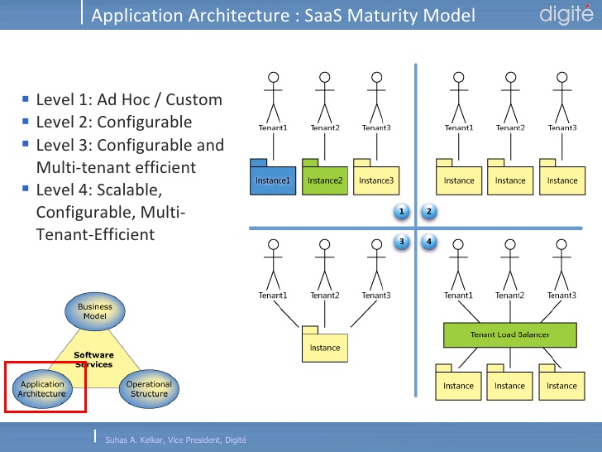

Slide 45
Key Characteristics of SaaS
Network-based management and access to commercially available software from central locations rather than at each customer’s site, enabling customers to access applications remotely via the Internet.

Slide 46
Key Characteristics of SaaS contd.
Application delivery from a one-to-many model (single-instance, multitenant architecture), as opposed to a traditional one-to-one model.

Slide 47
Key Characteristics of SaaS contd.
Centralized enhancement and patch updating that obviates any need for downloading and installing by a user. SaaS is often used in conjunction with a larger network of communications and collaboration software, sometimes as a plug-in to a PaaS architecture.

Slide 48
SaaS benefits
Reduced time to benefit
Lower costs
Scalability and integration
New releases (upgrades)
Easy to use and perform proof of concepts

Slide 49
SaaS benefits
Reduced time to benefit
Different from the traditional model, in SaaS the software (application) is already installed and configured. The user has the advantage of provisioning the server for an instance in cloud and in a couple hours they can have the application ready for use.
Lower costs
SaaS has a differential regarding costs since it usually resides in a shared or multitenant environment where the hardware and software license costs are low compared with the traditional model.
Another advantage is that the customer base can be increased since it allows small and medium businesses (SMB) to use a software that otherwise they would not use due to the high cost of license.

Slide 50
SaaS benefits
Scalability and integration
Usually, SaaS solutions reside in cloud environments that are scalable and have integration with other SaaS offerings. Comparing with the traditional model, users do not have to buy another server or software. They only need to enable a new SaaS offering and, in terms of server capacity planning, the SaaS provider will own that.
New releases (upgrades)
SaaS providers upgrade the solution and it becomes available for their customers. Costs and effort associated with upgrades and new releases are lower than the traditional model that usually forces the user to buy an upgrade package and install it, or pay for specialized services to get the environment upgraded.

Slide 51
SaaS benefits
Easy to use and perform proof of concepts
SaaS offerings are easy to use since they already come with best practices and samples inside it. Users can do proof of concepts and test the software functionality or a new release feature in advance. Also, they can have more than one instance with different versions and do a smooth migration. Even for large environments, users can use SaaS offerings to test the software before buy it.

Slide 52
Jericho Cloud Cube Model
Cloud computing offers a huge possibility for scalability, at almost instantaneous availability and low cost.
Business managers requires IT operations to assess the risks and benefit this representation of computing model .
The Jericho forum is an independent group of international information security leaders, have added their input as to how to collude securely in the clouds.
The Jericho Cloud Cube Model portrays the multidimensional elements of cloud computing, that frames not only cloud use cases but also how they are set up and used.

Slide 53
Jericho Cloud Cube Model
Cloud computing offers a huge possibility for scalability, at almost instantaneous availability and low cost.
Business managers requires IT operations to assess the risks and benefit this representation of computing model .
The Jericho forum is an independent group of international information security leaders, have added their input as to how to collude securely in the clouds.
The Jericho Cloud Cube Model portrays the multidimensional elements of cloud computing, that frames not only cloud use cases but also how they are set up and used.

Slide 54
Jericho Cloud Cube Model
The Jericho Forum’s objectives associated to cloud computing are unique – “enabling secure combination in the appropriate cloud formations suited best to the business needs”.
Protecting our Data
First, it is necessary to categorize our data so as to know what rules must be applied to protecting it
We only can meet this requirement if we have comprehensively adopted standards for data classification, metadata for cloud.
With consideration of what security we must apply to our data, we’re in a position to take decision on data migration, cloud composition and cloud levels (infrastructure, platform, Software, process, values)

Slide 55
Jericho Cloud Cube Model
The Jericho forum has identified 4 gauge for judgement to differentiate cloud formations from each other and manner of their provisions.
Cloud Cube Model Dimensions
Dimension: Internal (I) / External (E)
Dimension: Proprietary (P) / Open (O)
Dimension: Perimeterised (Per) / De-perimeterised (D-p) Architectures
Dimension: Insourced / Outsourced

Slide 56
Dimension: Internal (I) / External (E)
his dimension defines the physical location of the data such as where does the cloud form we want to use lie, inside or outside your organization’s boundaries.
It is Internal If it is within your own physical boundary.
It is External If it is not within your own physical boundary.
For example, while Amazon SC33 would be external at some location “off-site, virtualized hard disks in an organization’s data center will be internal.

Slide 57
Dimension: Proprietary (P) / Open (O)
This is the dimension that represents the state of ownership of the cloud technology, interfaces, services, etc.
Proprietary means that the organization that provides the service is keeping the means of arrangement under their ownership.
Open clouds use technology that is not proprietary, meaning that there are likely to be more suppliers, and user are not as strained in being able to share your data and using the same open technology collide with selected parties.

Slide 58
Dimension: Perimeterised (Per) / De-perimeterised (D-p) Architectures
The third dimension represents the “architectural mindset” - are you operating inside your traditional IT perimeter or outside it?
Perimeterised implies continuing to operate within the traditional IT perimeter
when operating in the perimeterised areas, you may simply extend your own organisation’s perimeter into the external cloud computing domain using a VPN and operating the virtual server in your own IP domain, making use of your own directory services to control access.
Then, when the computing task is completed you can withdraw your perimeter back to its original traditional position.

Slide 59
Dimension: Perimeterised (Per) / De-perimeterised (D-p) Architectures
De-perimeterised, assumes that the system perimeter is architected following the principles outlined in the Jericho Forum’s Commandments and Collaboration Oriented Architectures Framework.
In a de-perimeterised frame the data would be wrapped with meta-data and mechanisms that from inappropriate usage would protect the data .
In a de-perimeterised environment an organisation can associate securely with selected parties globally over COA capable network.
Notes:
de-perimeterisation^{[1]} is the removal of a boundary between an organisation and the outside world.

Slide 60
Dimension: Insourced / Outsourced
We define a 4th dimension that has 2 states in each of the 8 cloud forms: Per(IP,IO,EP,EO) and D-p(IP,IO,EP,EO), that responds to the question “Who do you want running your Clouds?”:
Outsourced: the service is provided by a 3rd party
Insourced: the service is provided by your own staff under your control
These 2 states describe who is managing delivery of the cloud service(s) that you use.

Slide 61
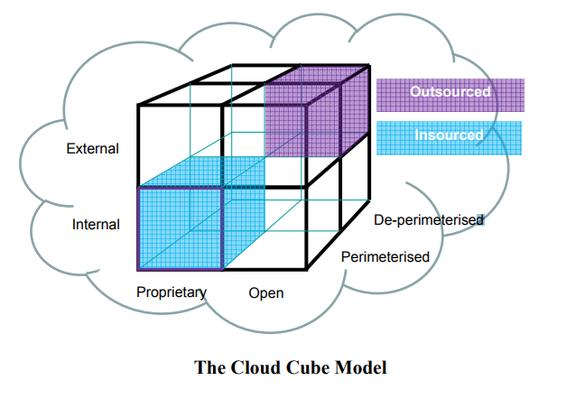
Jericho Cloud Cube Model

